Slide 1


Penguins Report
By: Anjola Okesola, Cleo Anne Tabacolde, Emily Dalson, Huong Giang Ho, and Lina Montesinos

Slide 2
The Dataset
A sample of 119 penguins of the Gentoo, Adelie, and Chinstrap species.
The penguins originate from the Torgersen, Biscoe, and Dream islands.
Clutch completion, culmen length, culmen depth, flipper length, body mass, and sex represent the data across the penguin species.

Slide 3
Description of Dataset
Variables & Purpose
Species: Used to group data and compare average body mass across species.
Body Mass: Measures weight in grams; used to compare between species and sexes.
Sex: Identifies male or female; used to analyze differences in physical traits.
Flipper Length: Length in mm; used to compare size between sexes.
Culmen Length : Beak length in mm; used to examine sex-based differences.
Culmen Depth: Beak depth in mm; used alongside length to study beak variation.
Key Relationships
Species and Traits: Physical traits vary by species
Sex and Traits: Males generally have larger body mass, flipper length, and culmen size
Species and Island: Certain species are tied to specific islands
Trait Correlations: Physical features are often interrelated

Slide 4

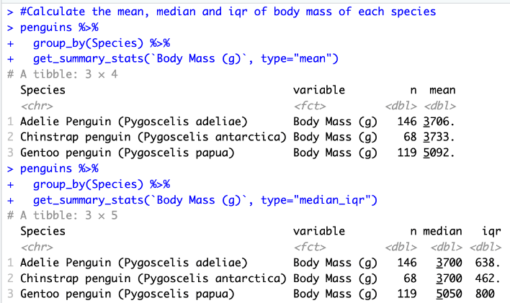

Descriptive Statistics
Mean, median, iqr of penguin species

Slide 5
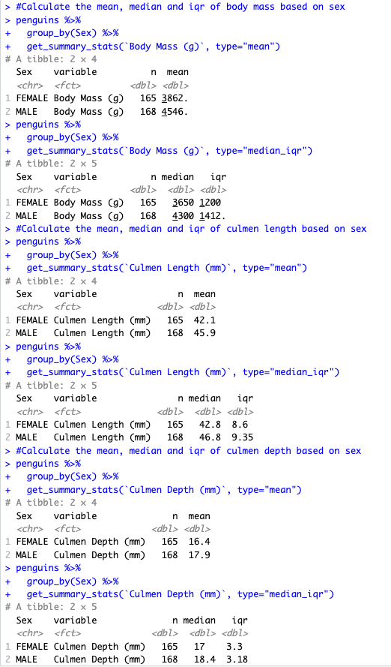
Descriptive Statistics
Mean, median, iqr of body mass on sex

Slide 6
Descriptive Statistics
Mean, median, iqr of culmen length and depth based on sex

Slide 7
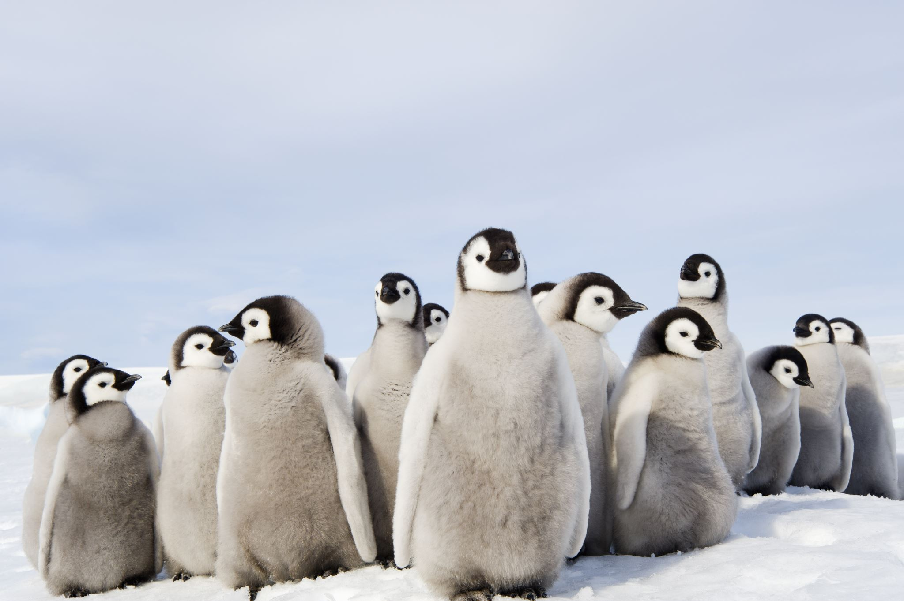
Research Question
Will there be a significant difference in culmen depth across the three penguin's species (Gentoo, Adelie, and Chinstrap)

Slide 8
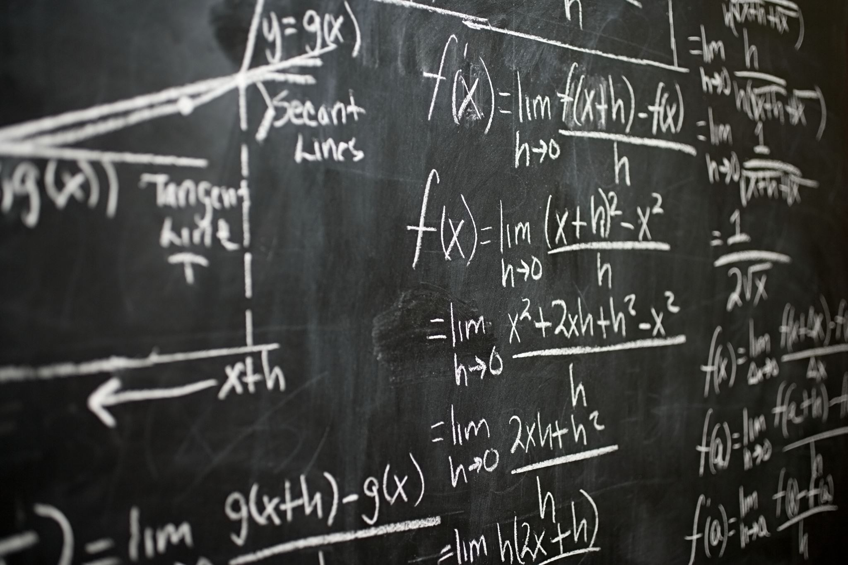
Hypotheses
Null Hypothesis (H₀): There is no difference in culmen depth mean across the three penguin species.
H₀ : μ₁ = μ₂ = μ₃
Alternative Hypothesis (H_{a}): At least one species has a different mean culmen depth.
H_{a} : μ_{1 ≠} μ_{2 ≠} μ₃

Slide 9

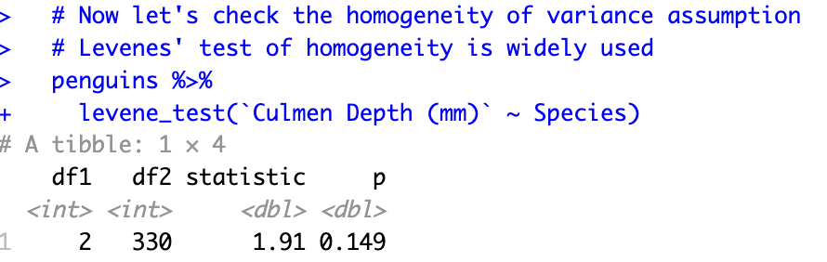
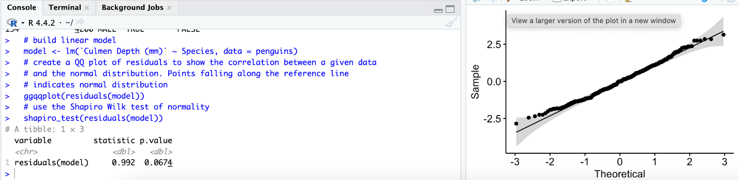
Analysis Method
Look for outlier: One non extreme outlier is identified
Normality test:
+ Build linear model between species and culmen depth
+ Create qq plot: points do fall along the reference line indicate normal distribution
+ Shapiro Wilk test: p = 0.067 > 0.05 => normal distribution
Levenes' test of homogeneity: check the homogeneity of variance assumption: p = 0.149 > 0.05 => non-significant, confirming homogeneity of variance

Slide 10
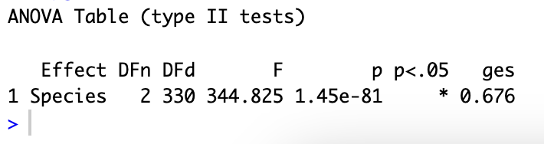
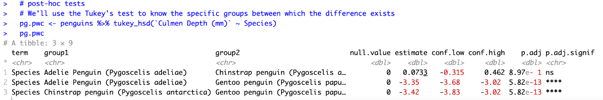
Analysis Method
Compute ANOVA test:
p = 1.45e-81<0.05 => there is significant difference among the three groups
Post-hoc tests:
Tukey's test to know the significant
between each pair
+ Adelie vs. Chinstrap: p = 8.97e- 1 = 0.897 (ns) > 0.05=> No significant difference between these two species
+ Adelie vs. Gentoo: p = 5.82e-13 < 0.05 => Extremely significant difference
+ Chinstrap vs. Gentoo: p = 5.82e-13 < 0.05 => Extremely significant difference

Slide 11
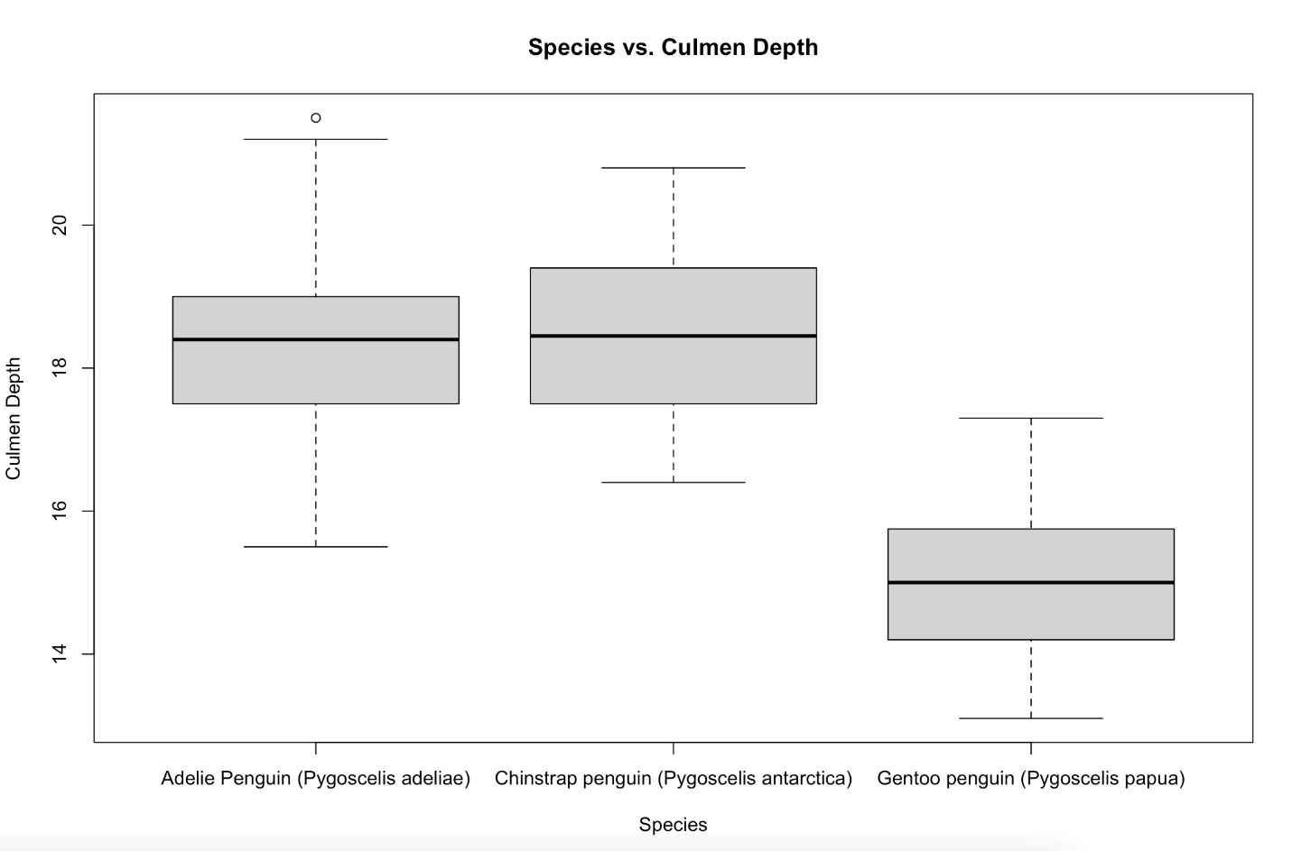
Results
1. Outlier Analysis
A preliminary outlier analysis using the interquartile range (IQR) method identified one non-extreme outlier (Culmen Depth = 21.5 mm) in the Adelie penguin group. The outlier was retained for analysis as it did not exceed the threshold for extreme outliers.
2. Normality Analysis
Normality of distribution was evaluated using both graphical and statistical methods: QQ plot inspection revealed that the distribution is normal with data falling along the reference line. Shapiro Wilk test also confirmed normality in distribution with p = 0.067 > 0.05
3. Homogeneity of variance assumption ​
Levene’s test of homogeneity indicated no significant heterogeneity across groups (p = 0.149),satisfying the assumption for ANOVA. ​
4. One-Way ANOVA ​
A one-way ANOVA revealed significant differences in culmen depth among the three penguin species (p = 1.45×10⁻⁸¹). ​
5. Post-Hoc Comparisons ​
Pairwise comparisons using Tukey’s test showed that Gentoo penguins exhibit significantly different culmen depth from both Adelie and Chinstrap species (p = 5.82e-13 < 0.05). No significant difference was detected between Adelie and Chinstrap penguins (p = 0.897 > 0.05)​
Cleo

Slide 12
Interpretation of Results
Statistical analysis shows culmen depth significantly differs among species
Gentoo penguins have distinct culmen depth compared to Adelie and Chinstrap
No significant difference between Adelie and Chinstrap
Culmen depth is a reliable trait for identifying Gentoo penguins but less effective for distinguishing Adelie vs. Chinstrap
Other physical traits (like body mass, flipper length, etc.) also vary by species and sex
Suggestions:
Focus further analysis on interactions between sex and physical traits
Aim to better understand gender-based differences across species
Cleo

